Slide 1



Master in Computer Applications
GANDHI INSTITUTE OF EXCELLENT TECHNOCRATS
Ghangapatna, Bhubaneswar
Code Sync
Presented By
Neha Swain
Chinmayee Mohanty
Mukti Prasad Dash
Anita Swain

Slide 2


Content:-
Introduction
Problem Statement
Objectives
Key-Features
Screen Shot of the Project
Advantages & Disadvantages
Future Scope
Conclusion
Future Scope

Slide 3

Introduction
Code Sync is an integrated, web-based tool designed to simplify coding tasks.
It supports writing and executing code in multiple programming languages directly from the browser.
Unique features include converting spoken code into text (Voice-to-Text) and extracting code or content from images (Image-to-Text).
Designed for students, developers, and educators needing a lightweight and accessible coding environment.

Slide 4

Technology Used
React jS
Node js
Express js
MongoDB
Notepad++ & vs code

Slide 5

Problem Statement:
Design a user-friendly, browser-based code editor that supports real-time output.
Offer multi-language support, including popular languages like C, Java, Python, JavaScript, HTML, and CSS.
Integrate speech recognition to allow users to dictate code through voice input.
Implement OCR (Optical Character Recognition) to extract code or text from image files.
Ensure code runs efficiently through backend integration and displays clean output.

Slide 6


Objectives
Design a user-friendly, browser-based code editor that supports real-time output.
Offer multi-language support, including popular languages like C, Java, Python, JavaScript, HTML, and CSS.
Integrate speech recognition to allow users to dictate code through voice input.
Implement OCR (Optical Character Recognition) to extract code or text from image files.
Ensure code runs efficiently through backend integration and displays clean output.

Slide 7
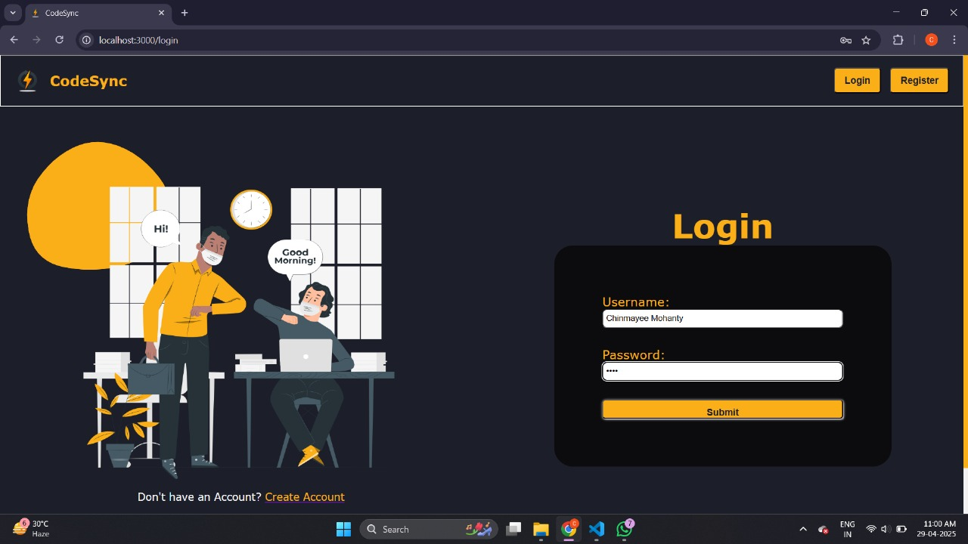
Features:-
Multi-language support
Voice-to-Text input
Image-to-Text extraction
Code Execution with output
Download / Copy code
Fully responsive UI

Slide 8
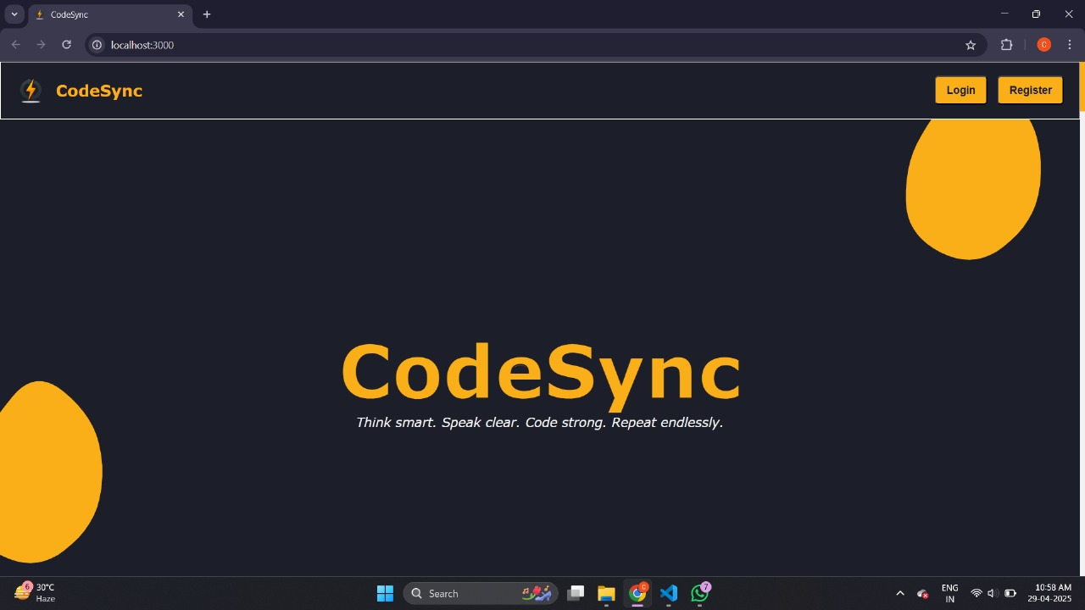

Slide 9
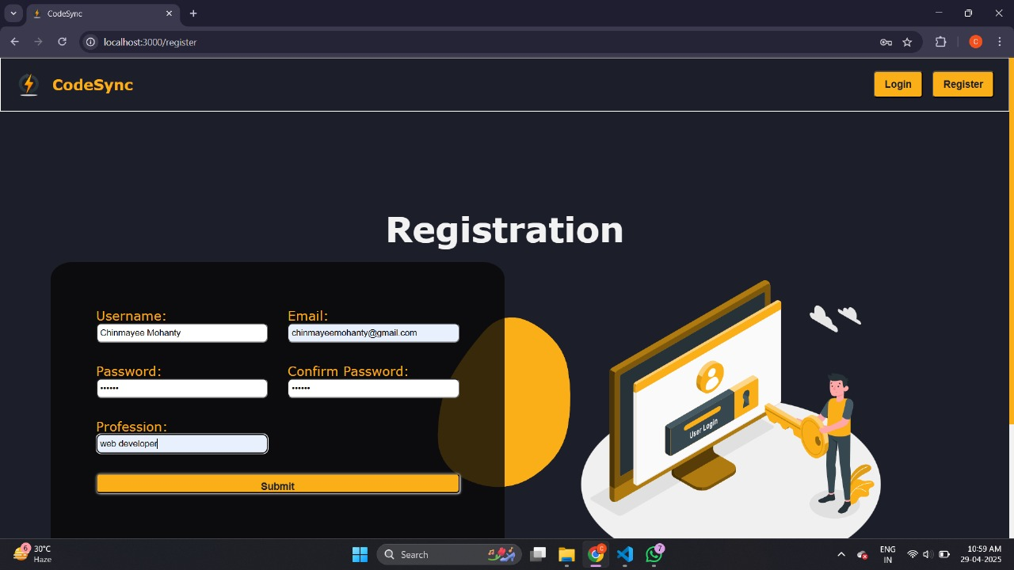

Slide 10
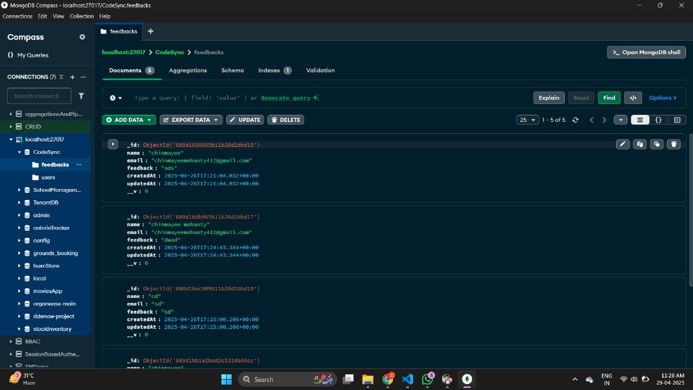

Slide 11
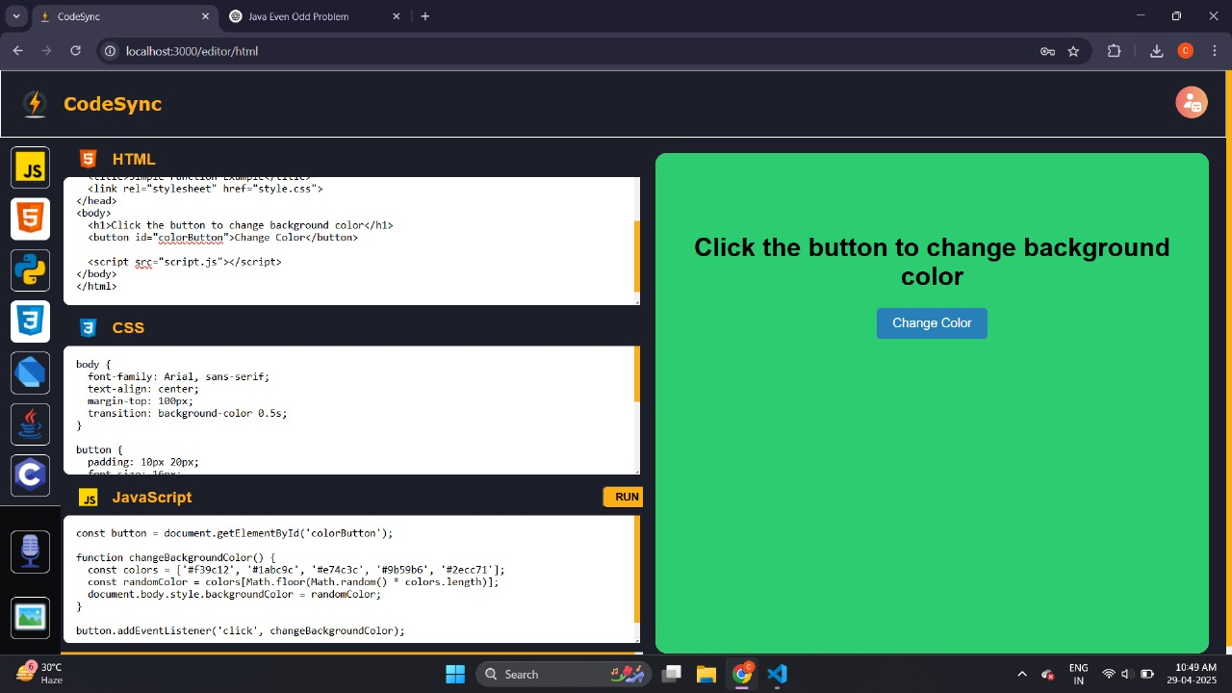

Slide 12

Future Scope
Add real-time code collaboration and messaging between users.
Allow users to save and version control their code.
Integrate AI to suggest and auto-complete code.
Build a mobile app or progressive web app (PWA).
Expand language support for more frameworks and compilers.

Slide 13

Advantages
Browser-based; no installation needed
All-in-one tool for coding, voice input, and OCR
Lightweight, fast, and user-friendly
Ideal for learners and quick prototyping
Disadvantages
Requires internet and server connection
Code execution limited to backend constraints
No real-time collaboration (can be a future enhancement)

Slide 14

Conclusion:-
CodeSync is barriers to coding by offering flexible input modes.
Ideal for students, educators, and casual coders looking for a fast, browser-based solution.
Easy to use and accessible fr a lightweight, versatile coding tool that combines text, voice, and image inputs.
It reduces om anywhere.

Slide 15


